Slide 1
Data Diagrams

Slide 2


Data Types
= primary key
= foreign key
userInformation
Field | Data Type
userID | int(11)
bankID | int(11)
accessibilityID | int(11)
first_name | varchar
last_name | varchar
email | varchar
password | varchar
phone_number | varchar
dob | date
prev_ticketIDs | varchar
points | int(11)
staff | varchar
bankingInformation
zoo_tickets
zoo_availability
Field | Data Type
bankID | int(11)
card_number | varchar
card_cvc | varchar
exp_date | varchar
card_holder | varchar
address | varchar
Field | Data Type
ticketID | int(11)
userID | int(11)
date_of_purchase | datetime
start_time | datetime
end_time | datetime
ticket_price | float(2, 2)
ticket_type | varchar
Field | Data Type
date | date
start_time | time
end_time | time
spaces | smallint(3)
ticket_type | varchar

Slide 3
Data Types 2
= primary key
= foreign key
blog
accessibility
hotel_rooms
hotel_availability
Field | Data Type
blogID | int(11)
creation_date | datetime
title | varchar
caption | varchar
image | varchar
Field | Data Type
accessibilityID | int(11)
dark_mode | bool
screen_reader | bool
mono_chromatic | bool
Field | Data Type
room_number | int(11)
userID | int(11)
booked | bool
start_time | datetime
end_time | datetime
room_price | float(3, 2)
capacity | smallint(1)
room_type | varchar
Field | Data Type
accessible | bool
room_number | int(3)
start_date | datetime
end_date | datetime
room_type | varchar

Slide 4
Data Dictionary - userInformation
Field | Data Type | Data Format | Field Size | Description | Example
userID | Integer | x…. | 11 | The user ID | 2
bankID | Integer | x…. | 11 | The key to the user’s bank information in the bankingInformation table | 3
accessibilityID | Integer | x…. | 11 | The key to the user’s accessibility information in the accessibility table | 4
first_name | Variable Character | - | 50 | The user’s first name | John
last_name | Variable Character | - | 50 | The user’s last name | Smith
email | Variable Character | xxxxx@xxxx.xxx | 255 | The user’s email address | john.smith@gmail.com
password | Variable Character | - | 255 | The user’s password for his/her account | password1234321
phone_number | Variable Character | 02x AAAA AAAA | 15 | The user’s phone number | +44 7123 456789
dob | Date | YYYY-MM-DD | - | The user’s date of birth | 2000-10-31
prev_ticketIDs | Variable Character | x…. | 11 | This is the IDs of the tickets the user has previously purchased | 1, 4, 6, 7, 9
points | Integer | - | 11 | This is the amount of points that the user has accumulated | 1234
staff | Variable Character | - | 255 | This says if they are staff or not, and what type of staff | admin

Slide 5
Data Dictionary - bankingInformation
Field | Data Type | Data Format | Field Size | Description | Example
bankID | Integer | x…. | 11 | The user’s bank ID | 2
card_number | Variable Character | - | 30 | The user’s card number | 4111111111111111
card_cvc | Variable Character | - | 5 | The user’s card cvc | 123
exp_date | Variable Character | - | 50 | The user’s card expiry date | 10/26
card_holder | Variable Character | - | 255 | The name on the user’s card | Mr. John Smith
address | Variable Character | - | 255 | The user’s billing address | Ian McSheerman, 20 Prince Street, London, SW4 0SB

Slide 6
Data Dictionary - zoo_tickets
Field | Data Type | Data Format | Field Size | Description | Example
ticketID | Integer | x…. | 11 | The ticket ID | 2
userID | Integer | x…. | 11 | The user’s ID of who the ticket belongs to | 3
date_of_purchase | Datetime | YYYY-MM-DD HH:MM:SS | - | When the ticket was purchased | 2020-12-31 23:59:59
start_time | Datetime | YYYY-MM-DD HH:MM:SS | - | The start time of the user’s ticket | 2020-12-31 23:59:59
end_time | Datetime | YYYY-MM-DD HH:MM:SS | - | The end time of the user’s ticket | 2020-12-31 23:59:59
ticket_price | Float | - | 4 | The price of the user’s ticket | 20.34
ticket_type | Variable Character | - | 255 | The type of ticket it is | Adult

Slide 7
Data Dictionary - zoo_availability
Field | Data Type | Data Format | Field Size | Description | Example
date | Date | YYYY-MM-DD | 11 | The date of the availability | 2020-12-31
start_time | Time | HH:MM:SS | 11 | The start time of the availability | 23:59:59
end_time | Time | HH:MM:SS | 11 | The end time of the availability | 23:59:59
spaces | Integer | - | 50 | The amount of spaces the availability has | 200
ticket_type | Variable Character | - | 50 | The type of ticket that is available at that time and date | Adult

Slide 8
Data Dictionary - blog
Field | Data Type | Data Format | Field Size | Description | Example
blogID | Integer | x…. | 11 | The blog’s ID | 2
creation_date | Datetime | YYYY-MM-DD HH:MM:SS | - | The creation date of the blog | 2020-12-31 23:59:59
title | Variable Character | - | 255 | The title of the blog | Red panda
caption | Variable Character | - | 255 | The text within the blog | This red panda is cool
image | Variable Character | - | 255 | The hyperlink for the image in the blog | https://upload.wikimedia.org/wikipedia/commons/thumb/e/e6/Red_Panda_%2824986761703%29.jpg/800px-Red_Panda_%2824986761703%29.jpg

Slide 9
Data Dictionary - accessibility
Field | Data Type | Data Format | Field Size | Description | Example
accessibilityID | Integer | x…. | 11 | The ID that links to the user table | 2
dark_mode | Boolean | - | - | Tells if dark mode is enabled or not | True
screen_reader | Boolean | - | - | Tells if screen reader is enabled or not | False
mono_chromatic | Boolean | - | - | Tells if mono chromatic mode is enabled or not | False

Slide 10
Data Dictionary - hotel_rooms
Field | Data Type | Data Format | Field Size | Description | Example
room_number | Integer | x…. | 3 | The room number | 2
userID | Integer | x…. | 11 | The user’s ID to who has taken it | 3
booked | Boolean | - | - | If the room is booked or not | True
start_time | Datetime | YYYY-MM-DD HH:MM:SS | - | The start staying time for the user who has taken it | 2020-12-31 23:59:59
end_time | Datetime | YYYY-MM-DD HH:MM:SS | - | The end staying time for the user who has taken it | 2020-12-31 23:59:59
room_price | Float | - | 5 | The price of the room | 123.45
capacity | Small Integer | - | 1 | The capacity of the room, i.e. how many people it can hold | 3
room_type | Variable Character | - | 255 | The type of room it is | Double Room

Slide 11
Data Dictionary - hotel_availability
Field | Data Type | Data Format | Field Size | Description | Example
accessible | Bool | - | - | If the room is accessible or not | True
room_number | Integer | x…. | 3 | The number of the room | 231
start_date | Datetime | YYYY-MM-DD HH:MM:SS | - | The start date and time when it is available from | 2020-12-31 23:59:59
end_date | Datetime | YYYY-MM-DD HH:MM:SS | - | The end date and time when it is no longer available from | 2020-12-31 23:59:59
room_type | Variable Character | - | 255 | The type of room it is | Double Room

Slide 12
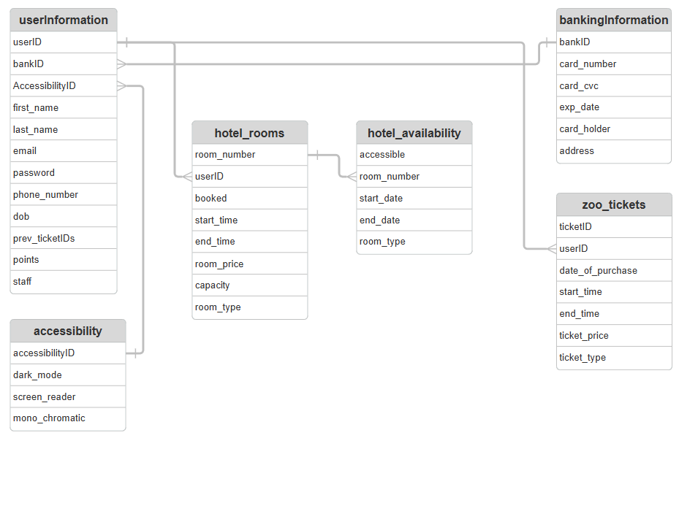
ERD Diagram

Slide 13
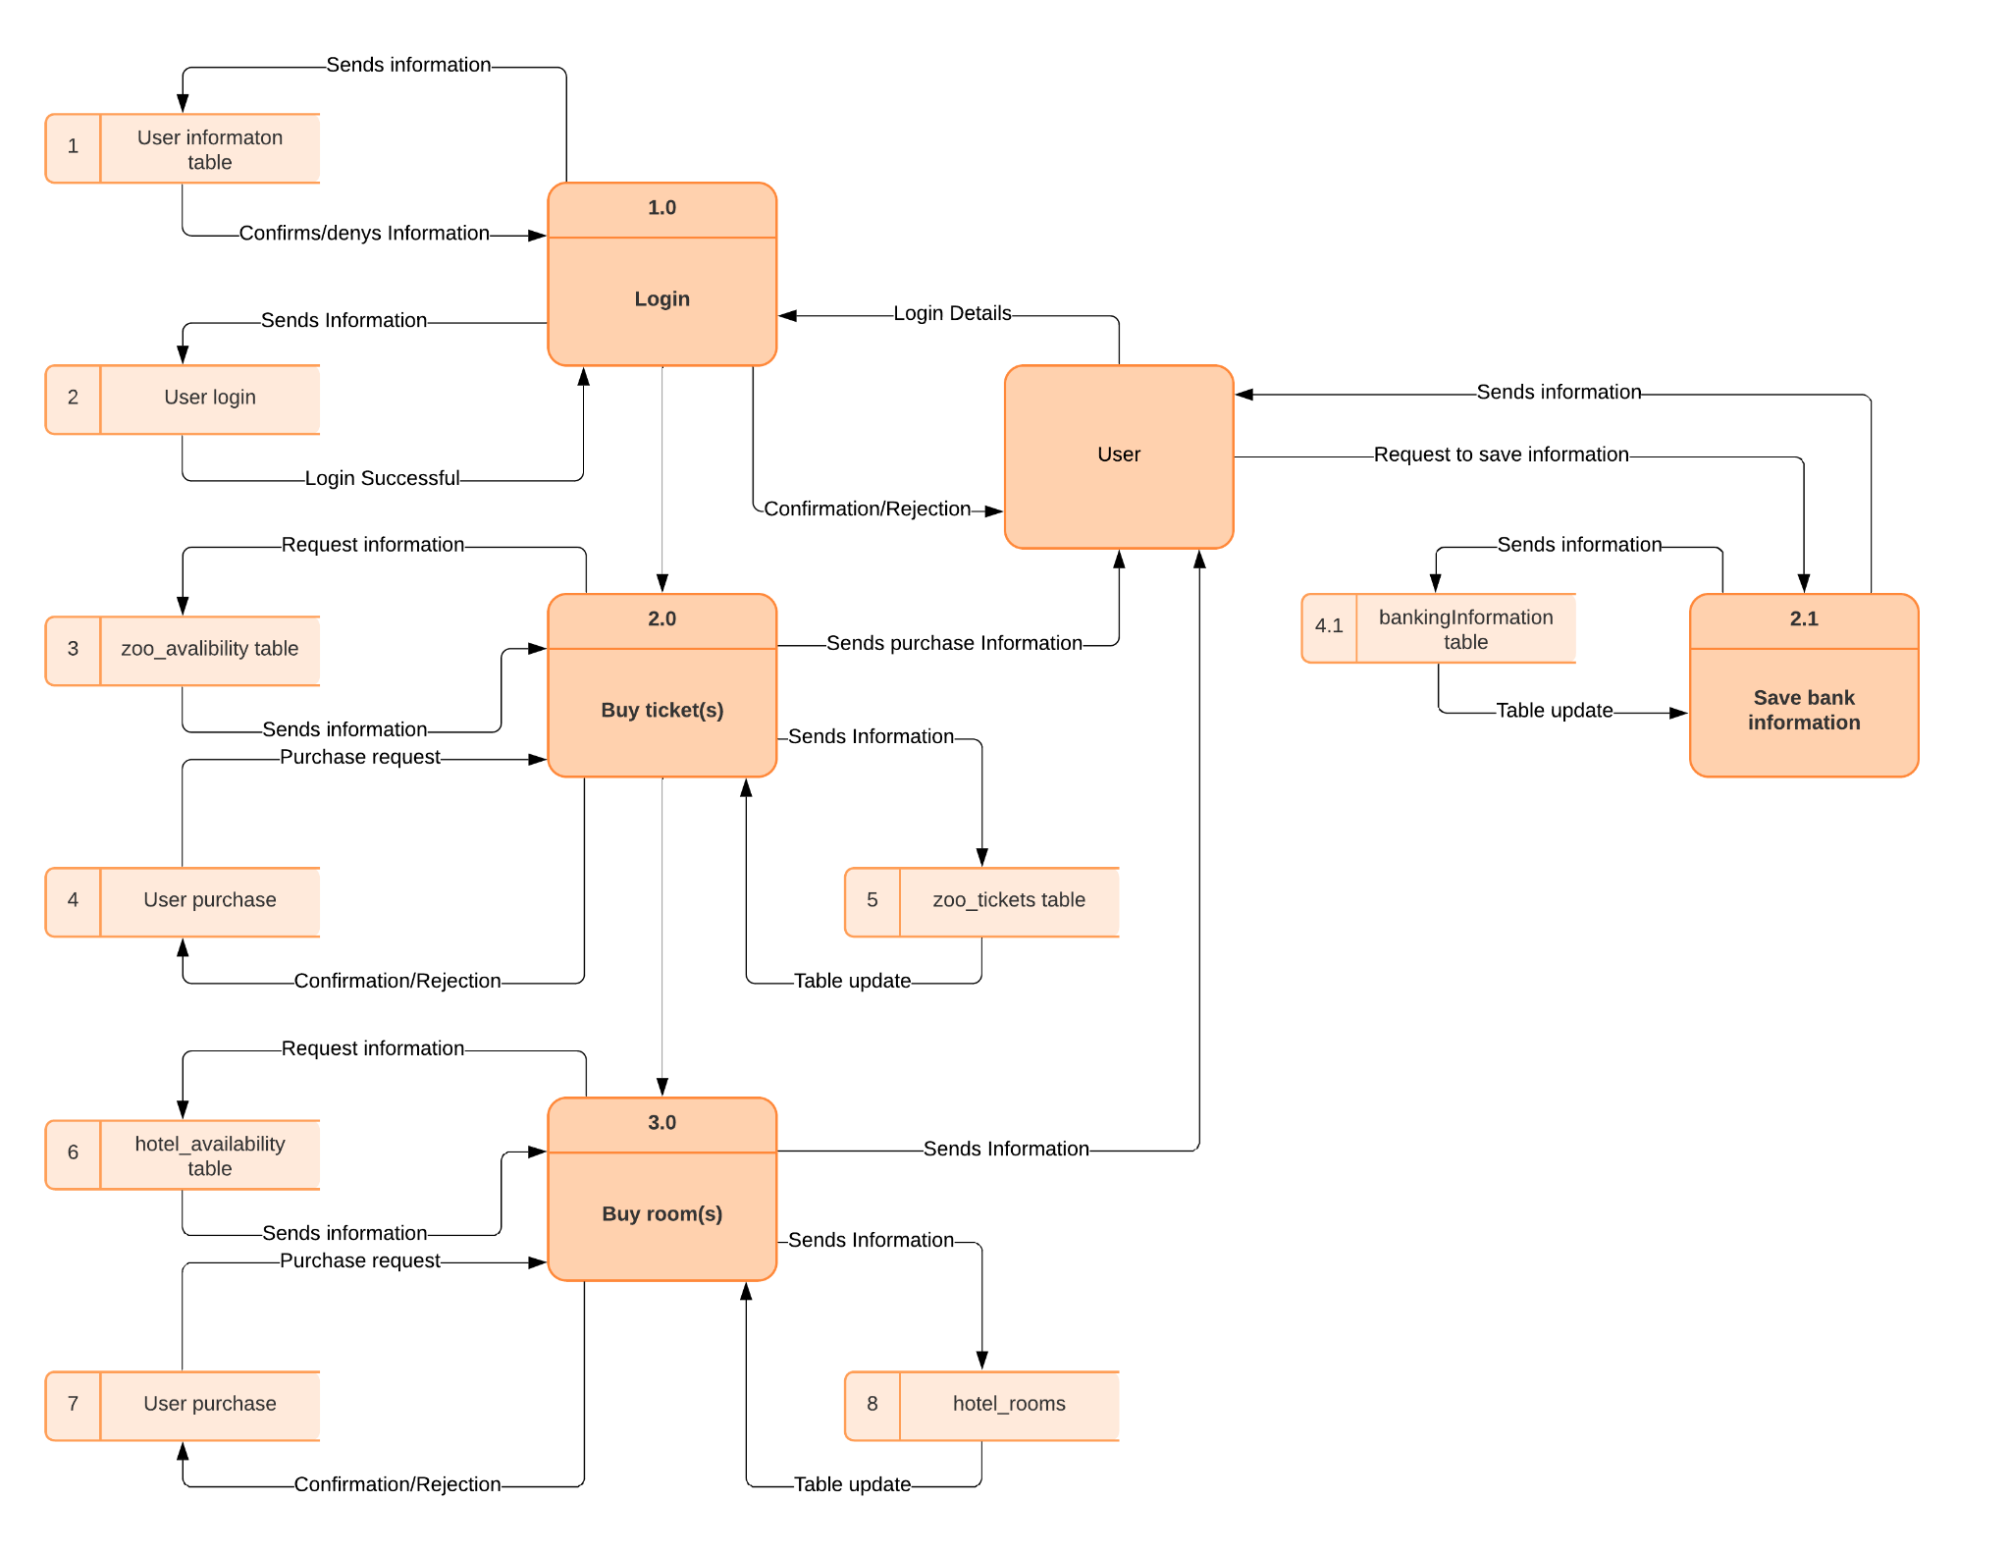
Data Flow Diagram

Slide 14
Algorithms
Your algorithm designs do not need to show the whole solution but should show how you would solve a number of different key problems.
You should limit your algorithm designs to a maximum of five complex problems.

Slide 15
Pseudocode - Sign Up

Slide 16
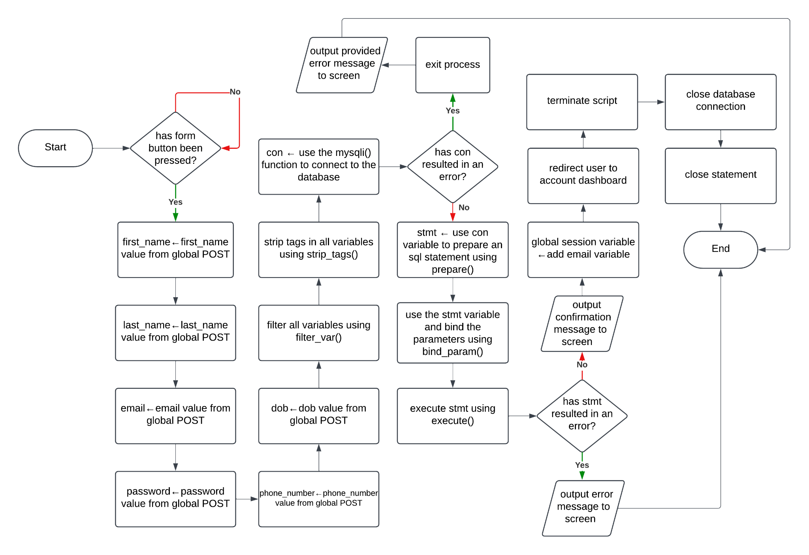
Flowcharts - Sign Up

Slide 17
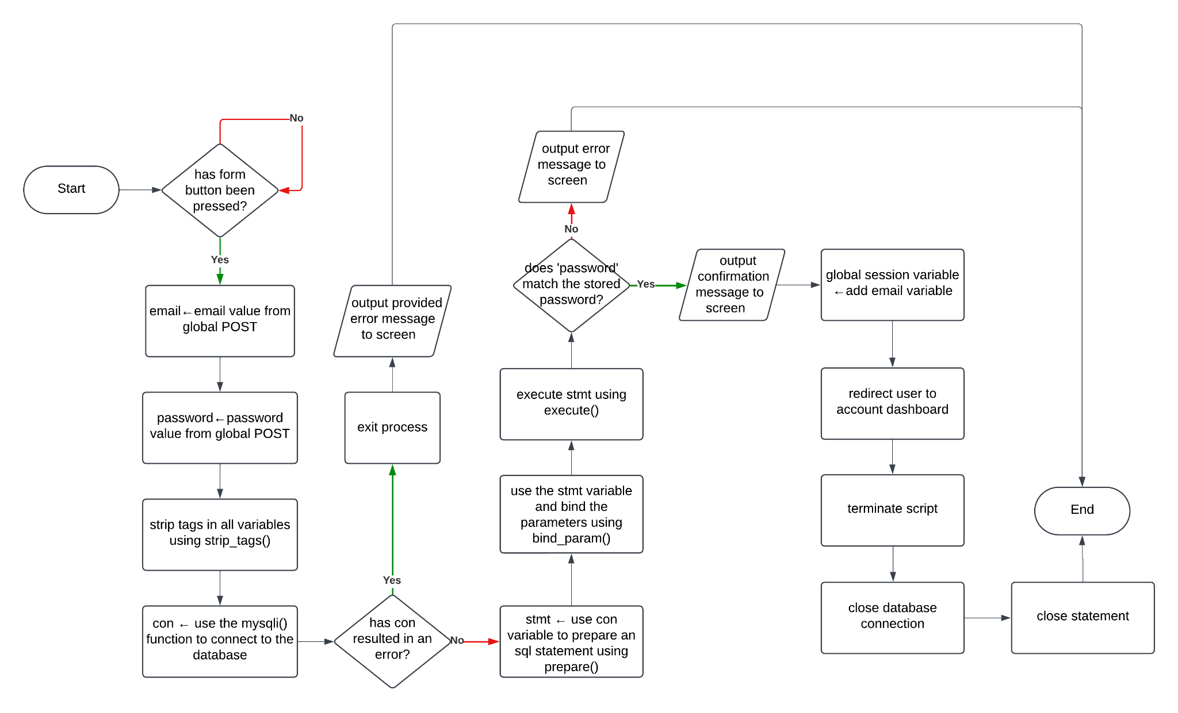
Flowcharts - Login

Slide 18
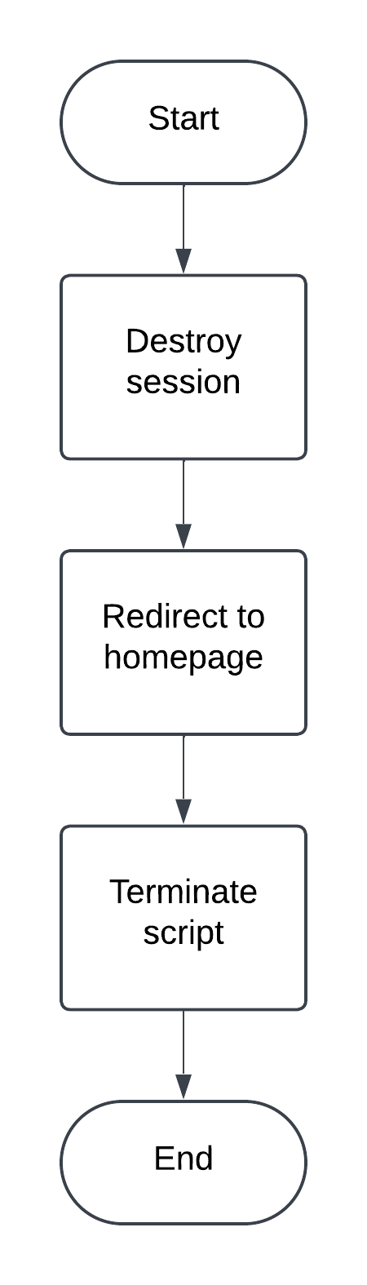
Flowcharts - Logout

Slide 19
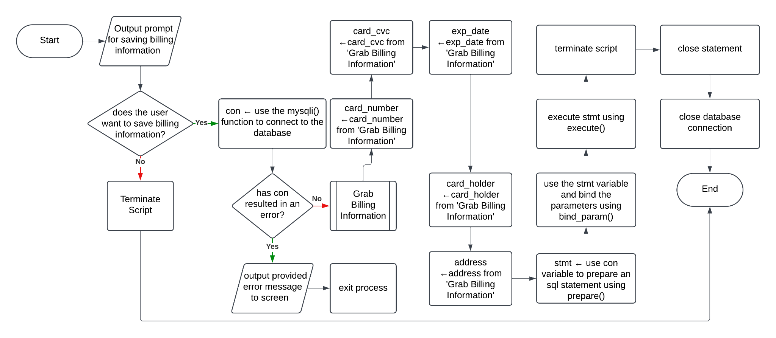
Flowcharts - Saving Billing Information (from checkout)

Slide 20
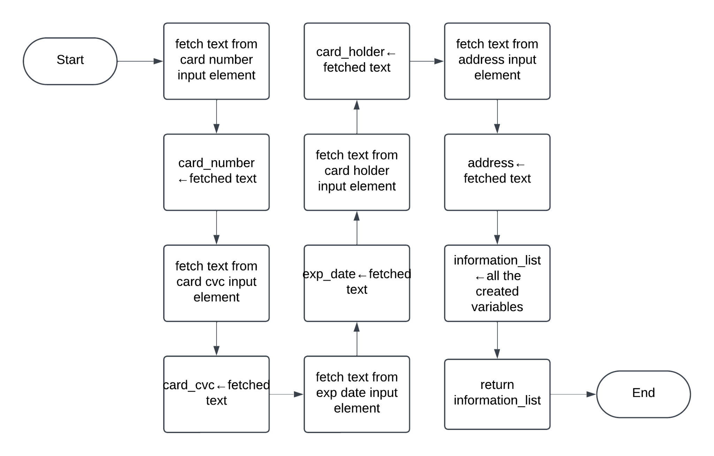
Flowcharts - Grab Billing Information (from checkout)

Slide 21
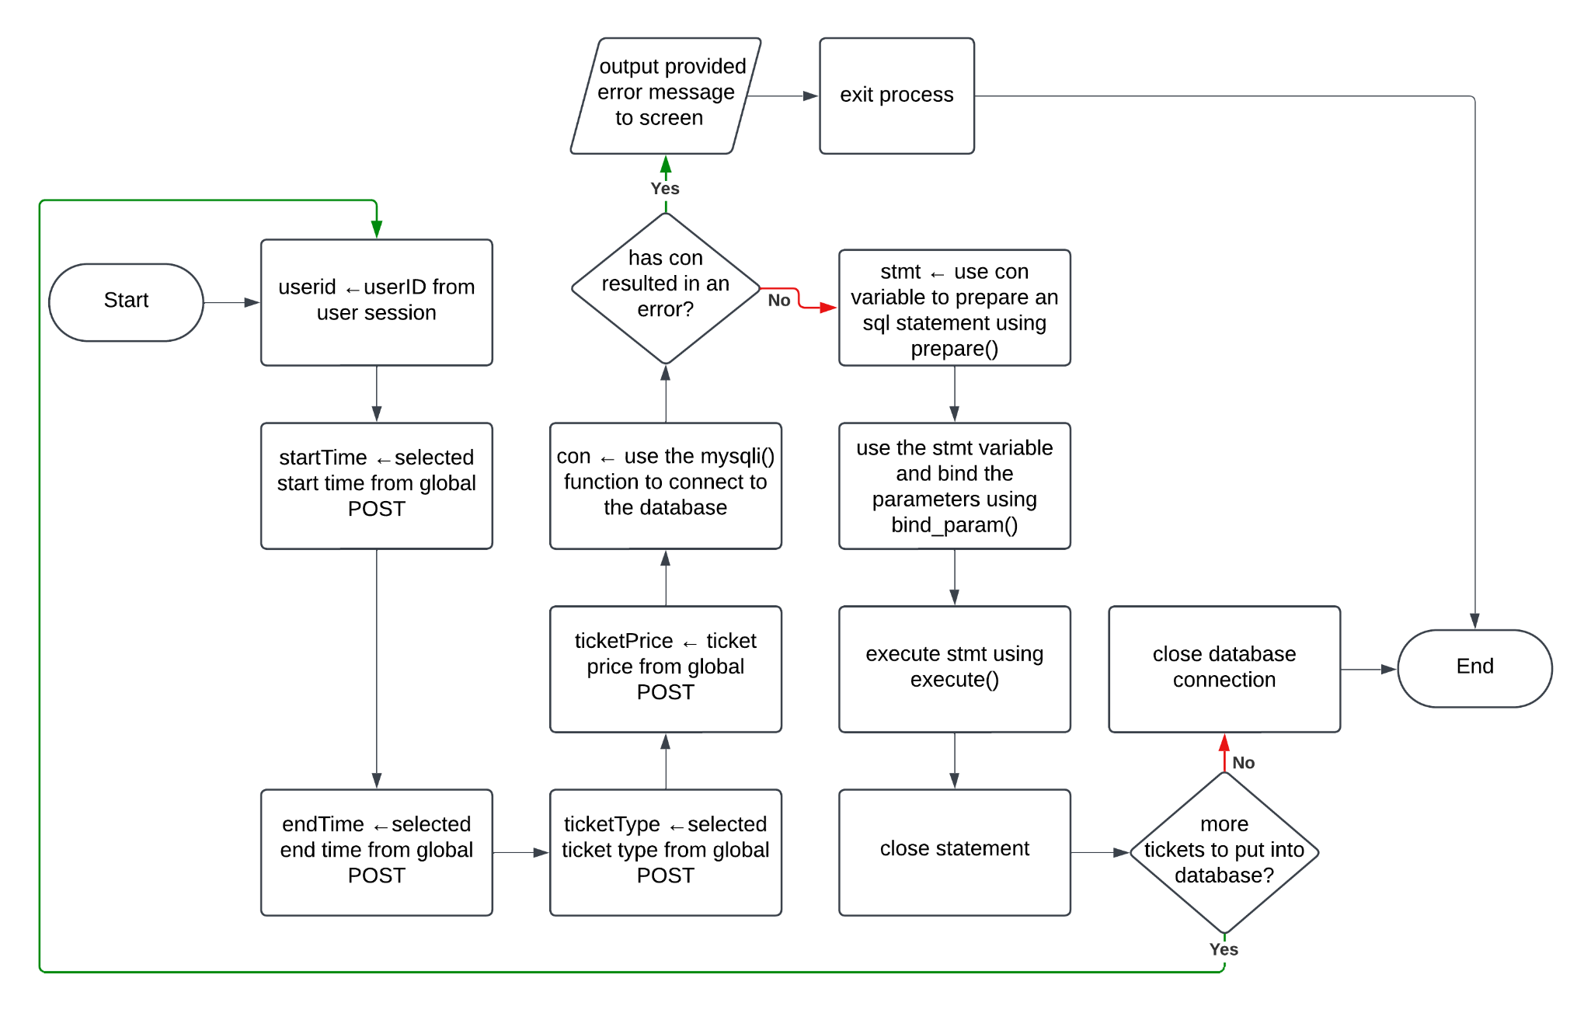
Flowcharts - Booking Zoo Tickets

Slide 22
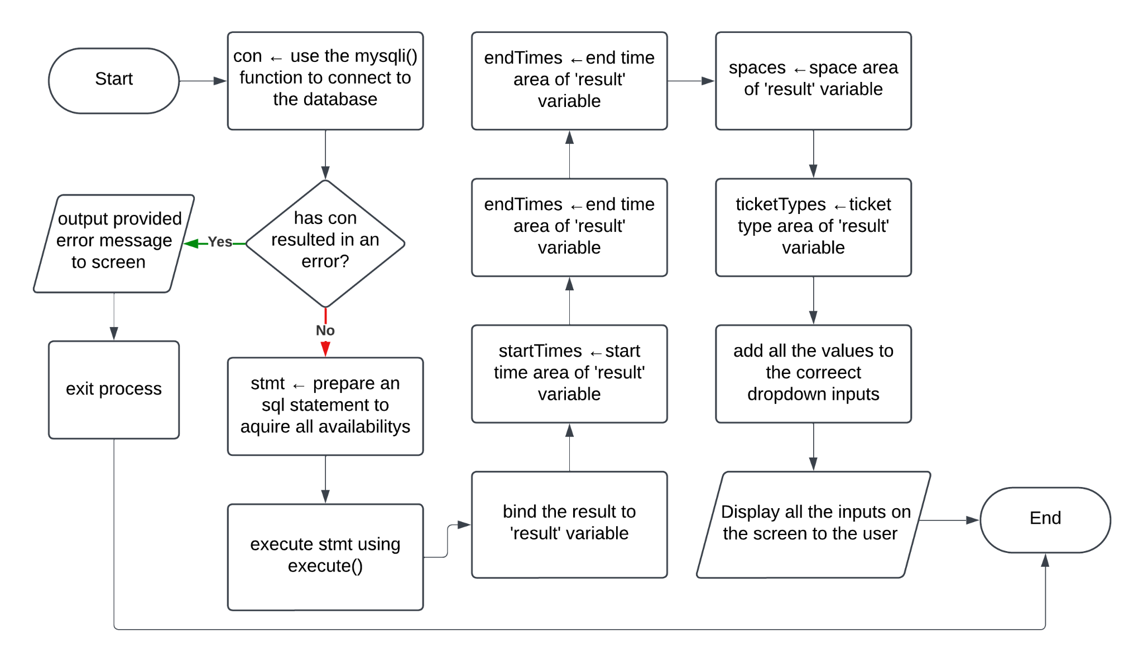
Flowcharts - Display Zoo Availability

Slide 23
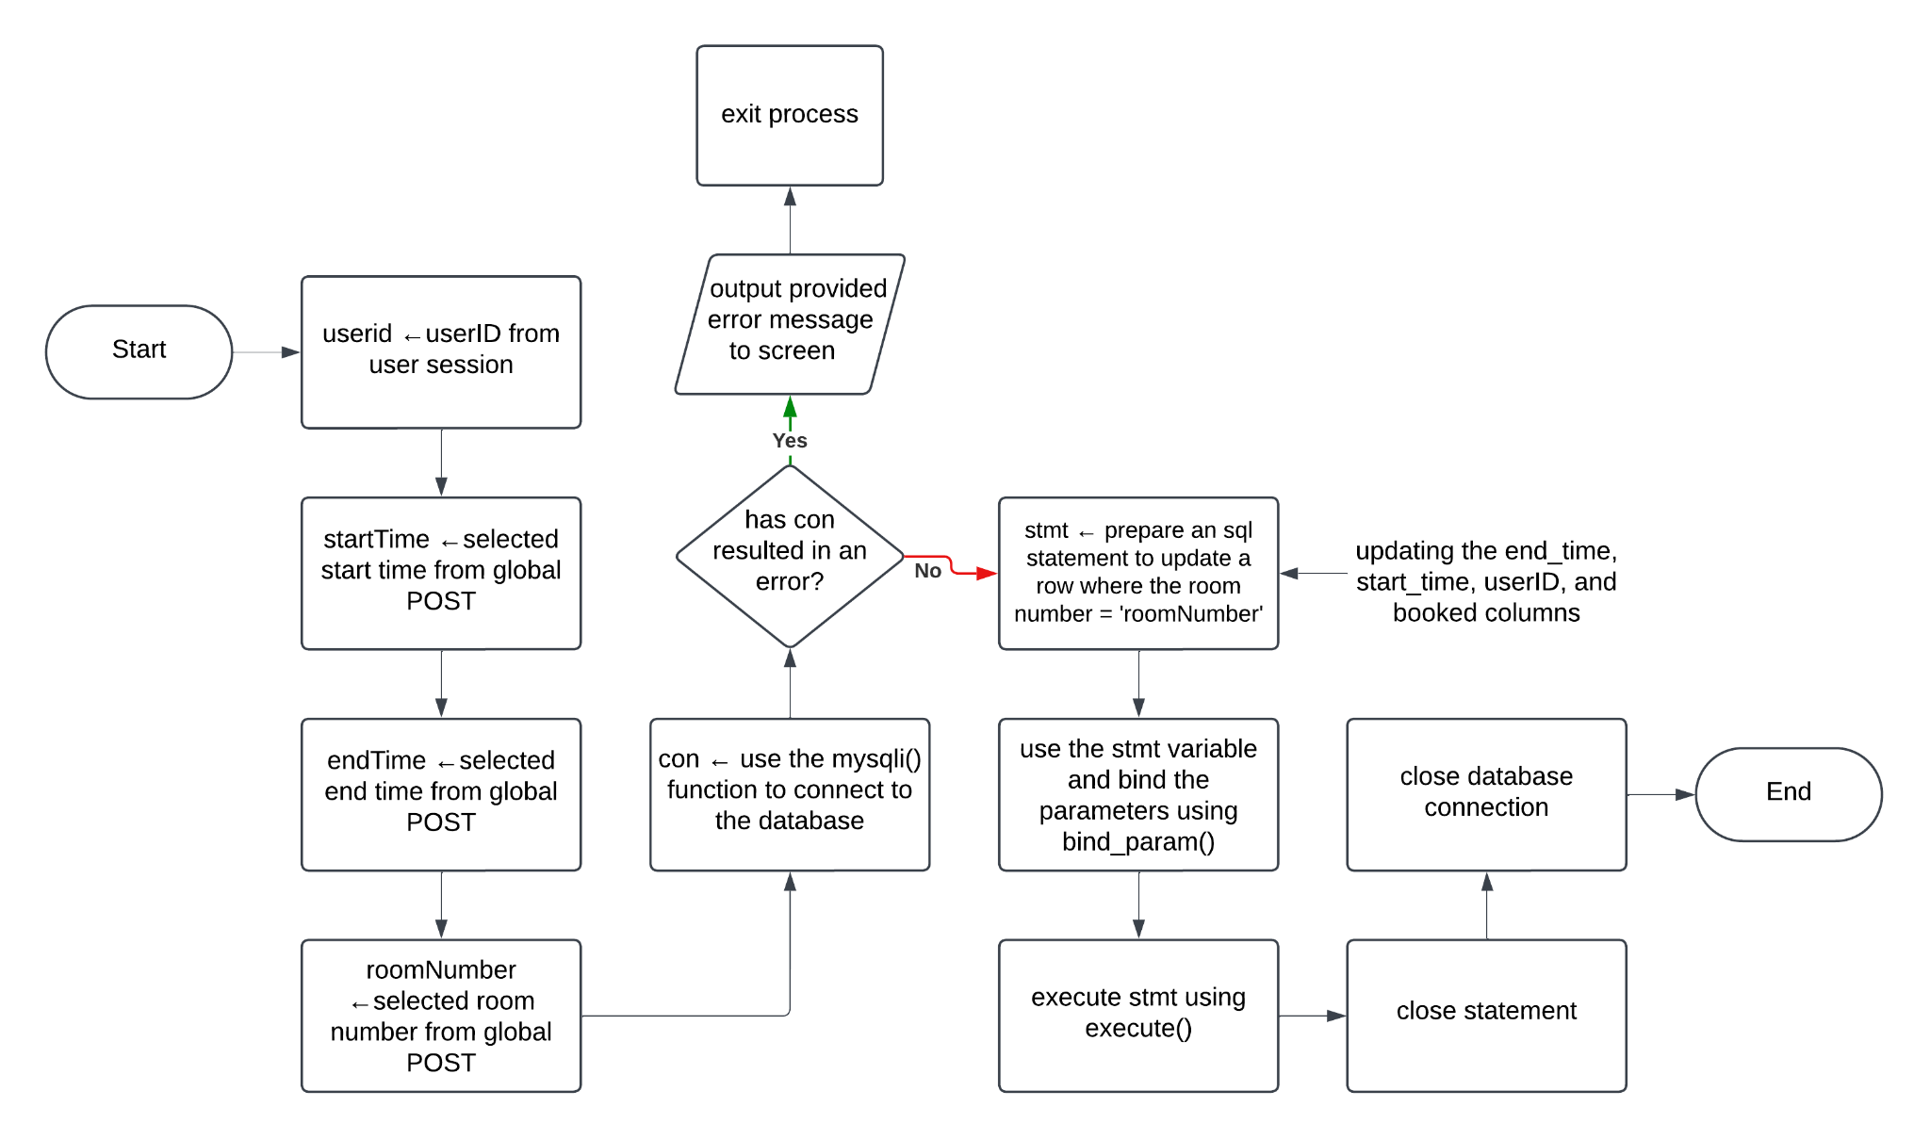
Flowcharts - Booking Hotel Rooms

Slide 24
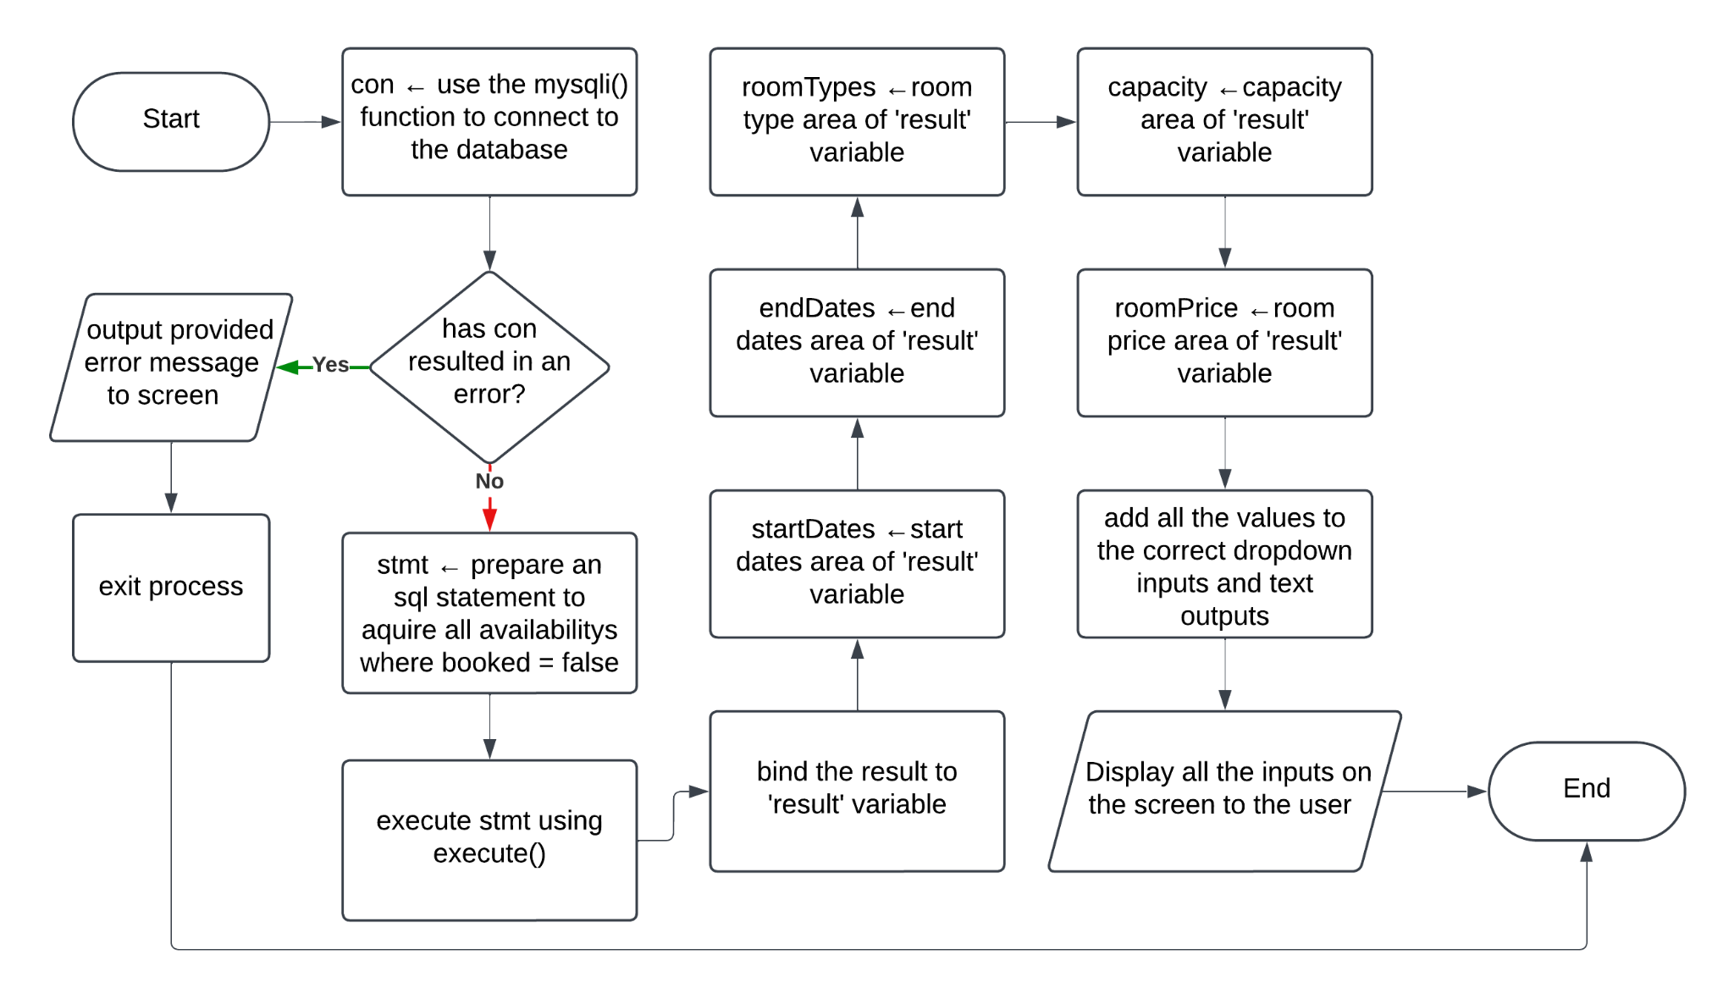
Flowcharts - Display Hotel Availability

Slide 25
Code (PHP, HTML, JS, CSS, etc.)

Slide 26
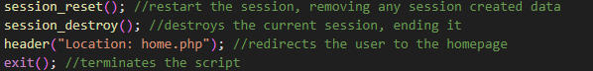
Code - Logout

Slide 27
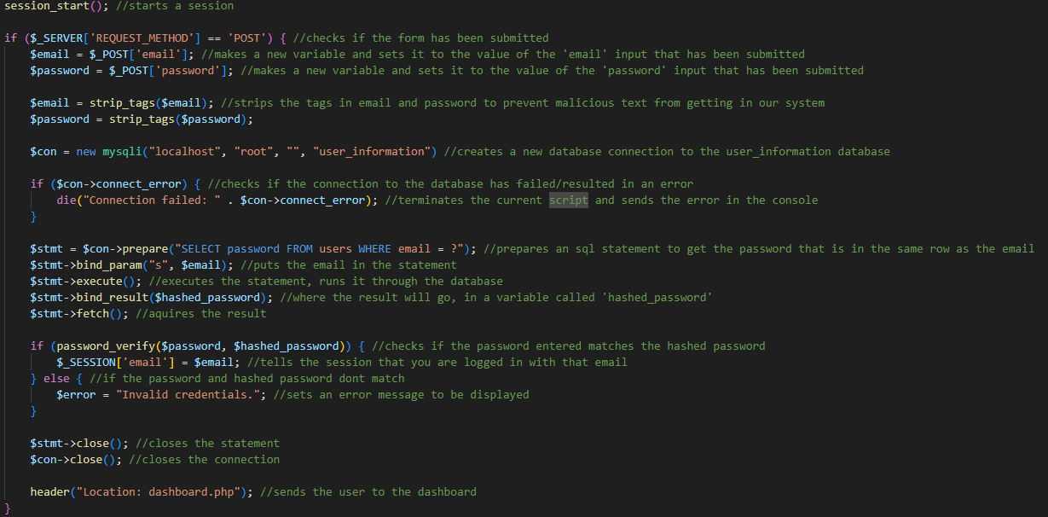
Code - Login

Slide 28
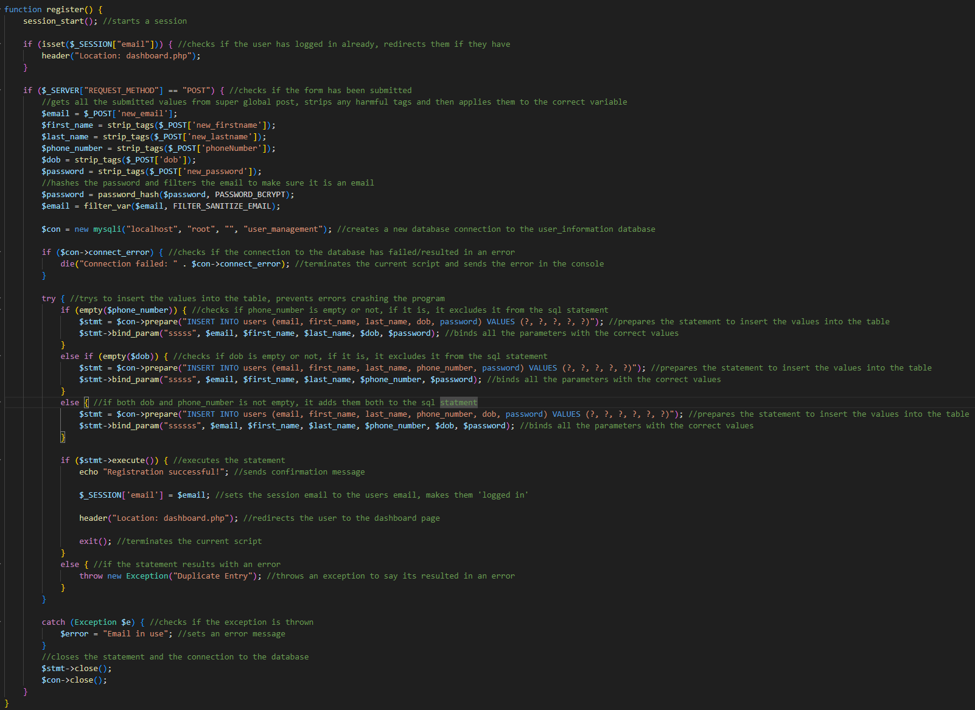
Code - Register

Slide 29
Site Diagrams

Slide 30
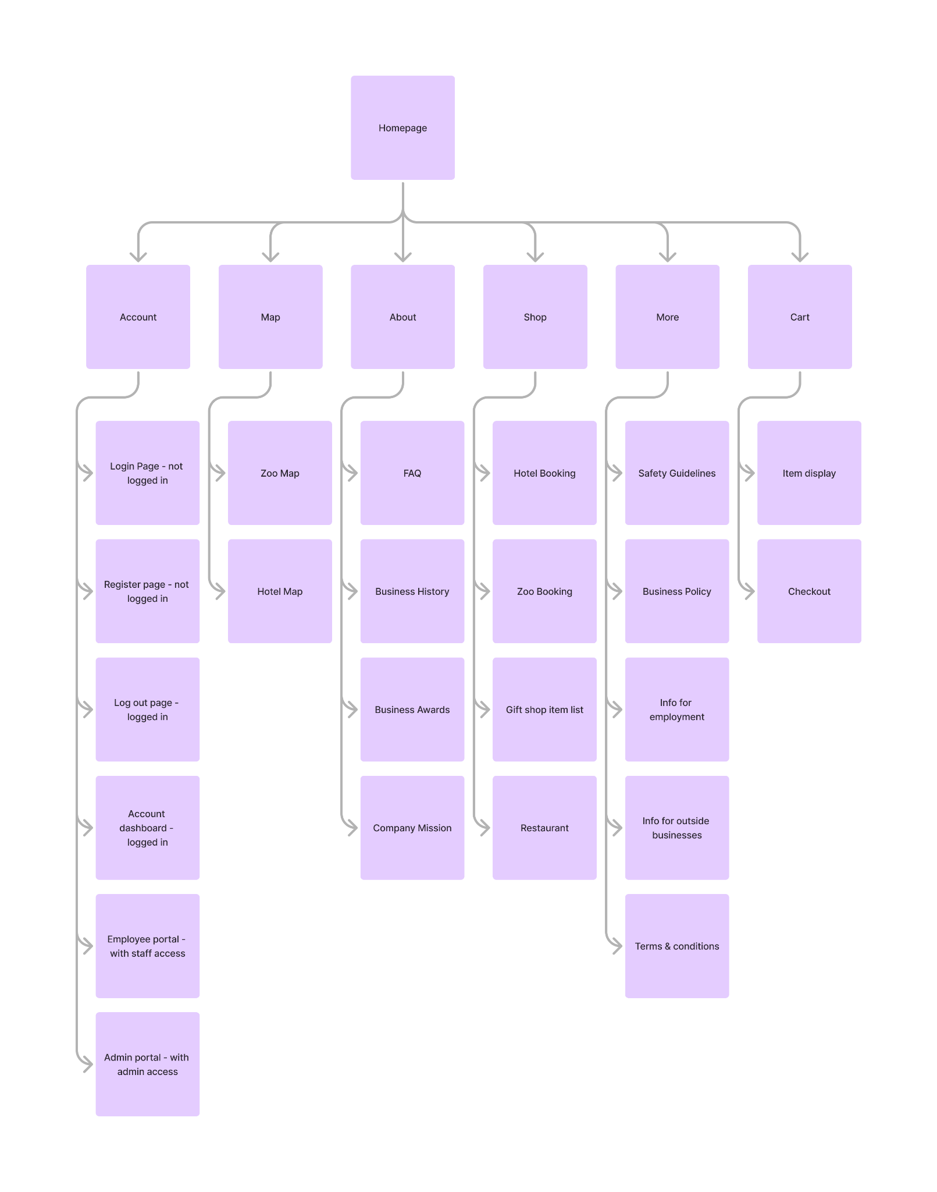
Site Map

Slide 31
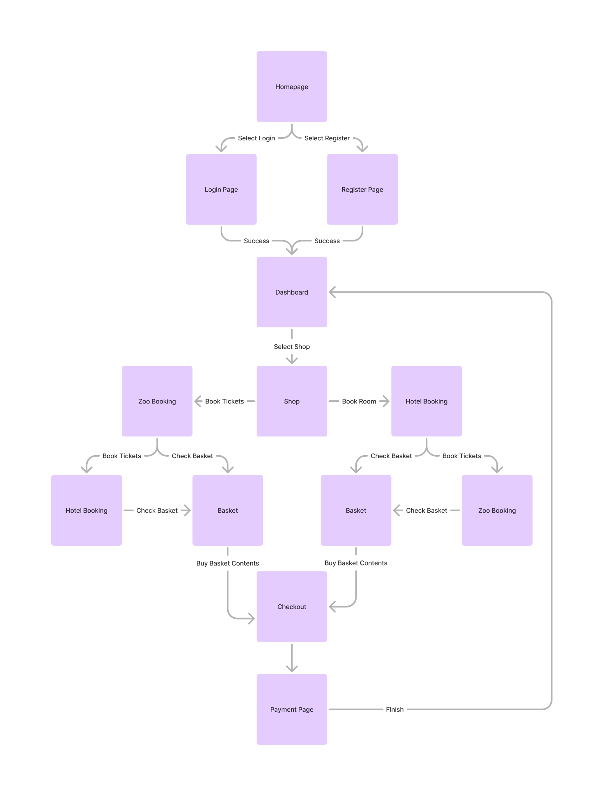
User Flow Diagram

Slide 32
Design

Slide 33
Page Specification
Colour scheme/ why
Font/Font size/ why
Logo / company strapline
How to show interactive elements or input boxes
An overall description of the layout and why you have designed it that way

Slide 34
Accessibility
Visually appealing
Well structured
Including standard layout
Images that reflect stakeholders focus
Accessibility WCAG guidelines
Descriptive alt text
User reviews
FAQs
Security/validation

Slide 35
Wireframes
High, medium, and low fidelity

Slide 36
Visual Designs

Slide 37
Prototypes

Slide 38






Tech Stack
Type | Name | Description
Back End | MySQL | A database management system, which is easily used and widely known.
Back End | PHP | A language used for making dynamic web pages and manipulating databases.
Front End | Javascript | A coding language commonly used for scripting within websites.
Front End | CSS | A language used to style elements on a web page.
Front End | HTML | A language used to layout elements on a web page.
API | Stripe | Stripe is used for collecting payments from users, or initiating subscriptions

Slide 39
Testing

Slide 40
Testing Strategy
Question:
What is the difference between Black Box testing and White Box testing?
We need to consider our overall testing strategy and to document this before we begin the test plan.
Explaining what strategy we used and how we are selecting both what components to test and the data we are testing from them is important.
We also should consider what outcomes from the test we might see and how we are going to respond to them?
Describe Black Box and White box testing
How do they differ in:
Test data
Test criteria
Test outcomes
When will you use this testing?
1. Test the UI:
• Conduct visual testing to ensure elements are laid out correctly.
• Test that all input elements are working correctly.
• Check that all forms are validating data correctly.
• Test navigation across all pages in the application.
• Perform accessibility testing to ensure users with disabilities can access the app.
2. Test the Backend:
• Verify that the APIs are returning the expected responses.
• Test that the data stored in the database is accurate.
• Check that any 3rd party integrations are working as expected.
• Perform load and stress testing to ensure the app can handle large amounts of traffic.
3. Test the Security:
• Check for SQL injection vulnerabilities.
• Test for Cross-site Scripting (XSS) vulnerabilities.
• Verify authentication and authorization mechanisms are working correctly.
• Ensure that proper encryption is being used for sensitive data.
4. Test the Performance:
• Test the response time of the app under various conditions.
• Measure the throughput of the application.
• Check that the app is able to handle multiple concurrent requests.
• Verify that the app is able to scale when necessary.

Slide 41
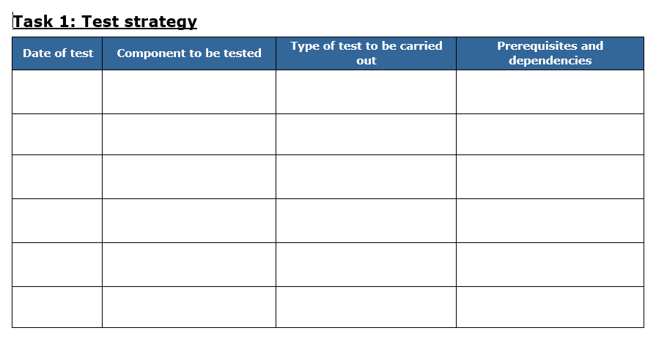
Test Plans

Slide 42
User Stories

Slide 43

Stakeholder type: Owner
Name: Michael Scott
Age: 35
Characteristics:
Stern
Loves animals
Friendly
Extrovert
Rich 🤑
User story:
I am the owner of the zoo, every now and then i go around the zoo and interact with the customers to check they are enjoying themselves.
I also like to feed and care for the animals, so usually some of the staff have a little extra break.
I am fairly lenient with my staff, but I won’t have them messing around if stuff still needs to be done.
Checking people are having fun
Interacting with staff
Use of services
Feeding and caring for animals
Admin work on the website

Slide 44

Stakeholder type: Staff
Name: John Smith
Age: 25
Characteristics:
Confident
Likes to go out
Extrovert
Easy going
User story:
I am working at the zoo, I enjoy the zoo, it’s nice to walk around.
Its large and high quality, so it keeps me occupied.
I am a bit strapped for cash at the moment, it pays well, especially since you get a discount for any services at the zoo.
Using website to use discounts on tickets
Staff work on the website, if needed
Use of services
Checking map of zoo
Helping customers

Slide 45
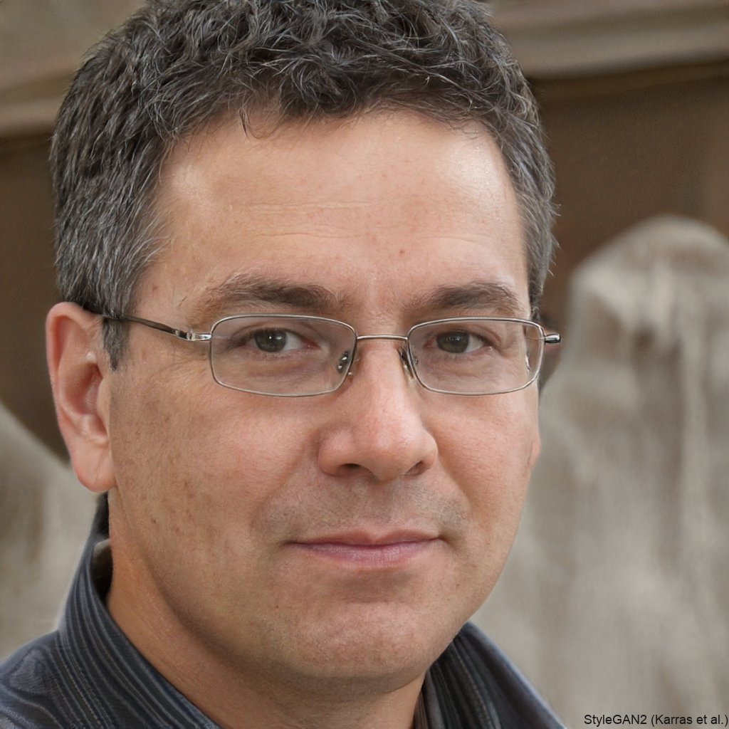
Stakeholder type: Educational
Name: Walter Richard
Age: 69
Characteristics:
Careful
Not a risk taker
Positive
User story:
I am checking out if this zoo is suitable for an educational trip for my students.
I’m hoping this zoo is kid friendly, however I am worried it will be too large and they will get bored too fast.
The cafe should be good quality, I want the kids to have good food if they are buying some.
Booking tickets on website
Eating at zoo cafe
Use of services
Checking map of zoo on website
Needs quick paths to exit zoo if needed

Slide 46

Stakeholder type: Customer
Name: Michael Scott Jr.
Age: 15
Characteristics:
Hyperactive
Introvert
Reluctant to spend money
Friendly
User story:
I am going on a trip to the zoo with my friends.
I’m going to get out of cleaning the house, I want the zoo to be big enough to walk around for a while.
I’ve got money for the gift shop, I’m going to buy some fun things.
Checking all the exhibits online
Eating packed lunch at cafe
Use of services
Using a map of the zoo
Buying things at the gift shop

